Slide 1
JAVASCRIPT STRING METHODS

Slide 2
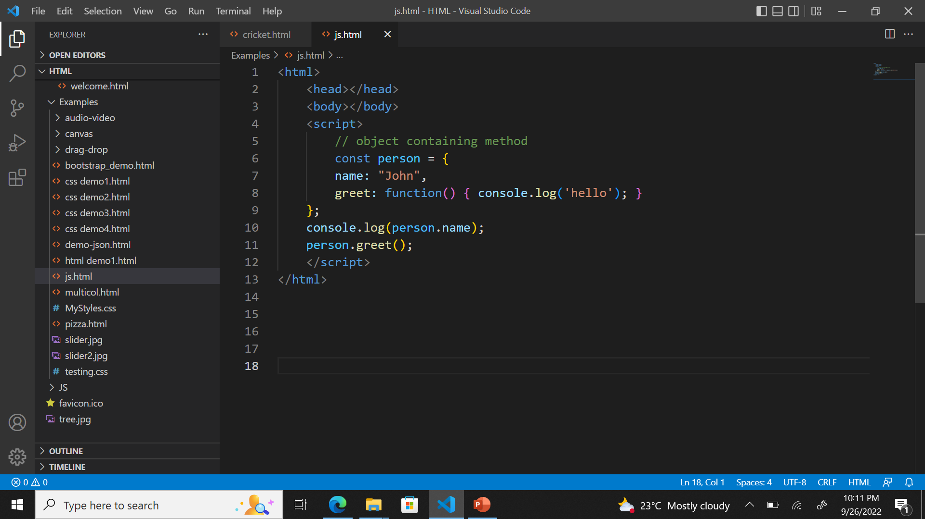
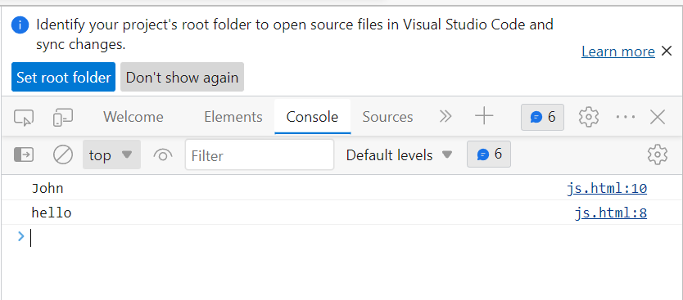
METHOD
JavaScript method is an object property that has a function value

Slide 3
Pre-Defined Methods
charAt
string.charAt(index*)
concat
string.concat(string1*, string2, ..., stringX)
endsWith
string.endsWith(searchvalue*, length)
includes
string.includes(searchvalue*, start)

Slide 4
Pre-Defined Methods
indexOf
string.indexOf(searchvalue*, start)
lastIndexOf
string.lastIndexOf(searchvalue*, start)
length
string.length
repeat
string.repeat(count*)

Slide 5
Pre-Defined Methods
replace
string.replace(searchValue*, newValue*)
search
string.search(searchValue*)
slice
string.slice(start*, end)
split
string.split(separator, limit)

Slide 6
Pre-Defined Methods
startsWith
string.startsWith(searchValue*, start)
substr
string.substr(start*, length)
substring
string.substring(start*, end)
toLowerCase
string.toLowerCase()

Slide 7
Pre-Defined Methods
toUpperCase
string.toUpperCase()
trim
string.trim()
trimEnd
string.trimEnd()
trimStart
string.trimStart()

